Slide 1
Fuel Efficiency Prediction and Analysis for Automotive Insight
Prepared by – Shubham Chougule

Slide 2
In our analysis of fuel efficiency prediction, we focus on identifying the key automotive attributes that significantly impact fuel efficiency. We address how missing values and outliers are managed to ensure data integrity. Through exploratory data analysis, we uncover trends and correlations within the dataset. We carefully select features for our predictive model based on their relevance and importance. Various machine learning algorithms are evaluated for their performance in predicting fuel efficiency, with a focus on understanding their accuracy and reliability. To effectively present our findings, we utilize power BI for creating interactive visualizations that enhance the understanding of the relationships between different attributes and fuel efficiency, making the data insights more accessible and engaging for the audience.

Slide 3
Agenda
Based on the extracted content, the document appears to be related to a data analysis project involving automobile attributes and fuel efficiency. The document covers various aspects such as data loading, exploratory data analysis (EDA), data preprocessing, visualization, and predictive modeling using Python libraries like pandas and seaborn. The dataset includes attributes such as mpg, cylinders, displacement, horsepower, weight, acceleration, model year, origin, and car name. The analysis involves addressing string values in the dataset, standardizing data, and implementing predictive models to predict fuel efficiency.
following topics to cover in the presentation of predictive model
1. Loading the data
2. Exploratory Data Analysis (EDA)
3. Visualization
4. Data Preprocessing
5. Predictive Modeling

Slide 4
Datasets And Data Field
Dataset :
Autos_mpg.csv – ( Dataset of Fuel Efficiency )
Dictionary File – ( explaining the content in the data)
Data field
mpg: Car's fuel efficiency measured in miles per gallon.
cylinders: Number of cylinders in the car's engine.
displacement: Engine displacement in cubic inches.
horsepower: Engine power output measured in horsepower.
weight: Car's weight in pounds.
acceleration: Time taken for the car to reach a certain speed from standstill.
model_year: Year of manufacturing or model release.
origin: Country of origin or manufacture of the car.
car_name: Unique identifier for each car instance.

Slide 5
Key Metrics
We worked with a dataset of 398 vehicles to predict fuel efficiency (MPG) using various metrics like horsepower, weight, cylinders, displacement, acceleration, origin, and model year. First, we cleaned the data by handling null values in the 'horsepower' column and converting strings to integers. We also normalized the 'weight' column for consistency. After splitting the data into training and testing sets, we built two models: Linear Regression and Support Vector Regression (SVR). Linear Regression performed slightly better with 80% accuracy, compared to SVR's 79%. This project highlights the main factors affecting fuel efficiency and shows how effective predictive modeling can be.

Slide 6
Dividing the data in 4 phase
1. Loading and Exploratory Data Analysis (EDA)
2. Visualizing the Data
3. Data Preprocessing
4. Model Building and Evaluation with conclusion

Slide 7
1.Loading and Exploratory Data Analysis ( EDA )
Data Overview:
The dataset contains 398 rows and 9 columns with various data types (floats, integers, and strings).
Identified null values in the 'horsepower' column and dropped the rows with null values.
Data Conversion:
Converted 'horsepower' from strings to integers using LabelEncoder to prepare for visualization and analysis.

Slide 8
2. Visualizing the Data
Most vehicles have an MPG between 15 and 40.
Majority of horsepower counts are above 50.
Most vehicles originate from region 1.
A few cars exhibit high horsepower and over 40 MPG.
Most vehicles have four cylinders and weigh between 2000 - 4500 lbs.
No significant outliers in horsepower, but some outliers were found in acceleration.
Model Year Insights:
Vehicles from model year 70 have the highest displacement, followed by those from 73.

Slide 9
Data Preprocessing
String Value Handling:
Dropped the 'car_name' column to focus on numerical data.
Data Scaling:
Used Standard Scaler to normalize the 'weight' column for consistent data.
Data Splitting:
Divided the data into training and testing sets, with 'mpg' as the target variable.

Slide 10
Model Building and Evaluation with Conclusion
Algorithms
Conclusion
Linear Regression:
Chosen due to the linear nature of the data.
Achieved an accuracy of 80%.
Support Vector Regression (SVR):
Used for potentially better accuracy.
Achieved an accuracy of 79%.
Both Linear Regression and SVR were effective in predicting fuel efficiency, with Linear Regression slightly outperforming SVR.
The project provides a comprehensive analysis of factors affecting fuel efficiency, including horsepower, weight, cylinders, displacement, acceleration, origin, and model year.

Slide 11
Let’s Explore With Power BI Dashboard

Slide 12
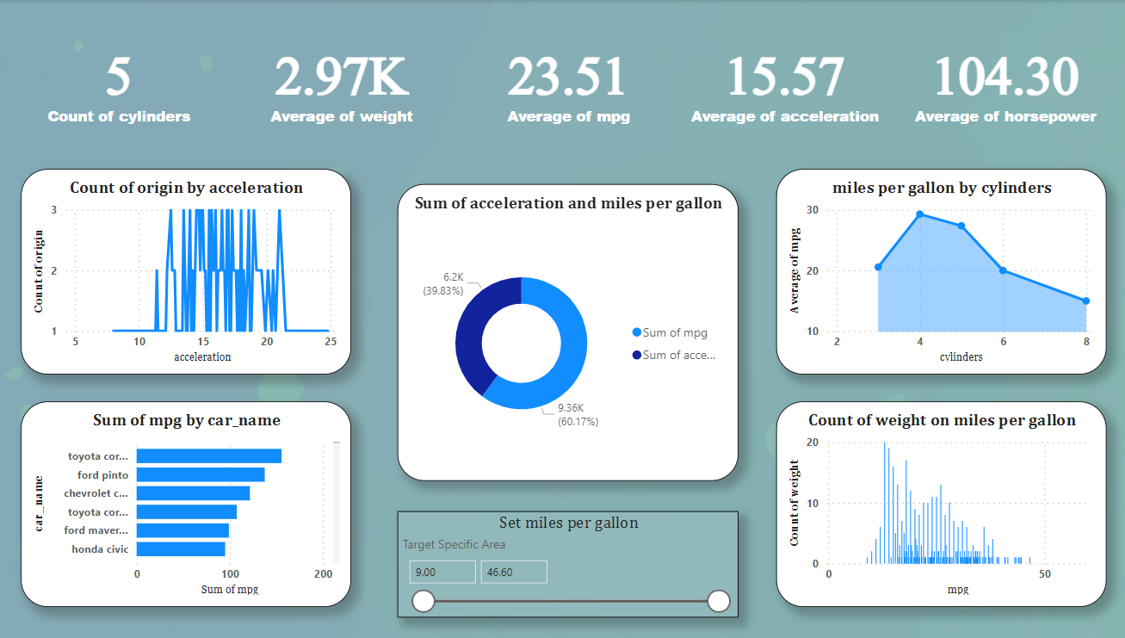

Slide 13
Key Insights from the Fuel Efficiency Dashboard
Top Performers in Fuel Efficiency:
The dashboard highlights that the Toyota Corolla and Honda Civic are among the top performers in terms of miles per gallon (mpg). These models consistently show higher mpg values, indicating superior fuel efficiency.
Acceleration vs. Fuel Efficiency:
There is a clear distinction between vehicles with high acceleration and those with high fuel efficiency. Cars with higher acceleration tend to have lower fuel efficiency, and vice versa. This trade-off is crucial for consumers prioritizing either performance or fuel economy.
Impact of Cylinders on Fuel Efficiency:
The analysis shows that vehicles with fewer cylinders generally have better fuel efficiency. Specifically, cars with 4 cylinders have a significantly higher average mpg compared to those with 6 or 8 cylinders. This suggests that smaller engines are more economical.

Slide 14
Key Insights from the Fuel Efficiency Dashboard
Weight and Fuel Efficiency:
Heavier vehicles tend to have lower fuel efficiency. The count of vehicle weight versus mpg indicates that as the weight of the vehicle increases, the miles per gallon decrease. This relationship underscores the importance of vehicle weight management in enhancing fuel efficiency.
Horsepower and Fuel Efficiency:
The dashboard provides a comparison between horsepower and fuel efficiency, where vehicles with higher horsepower do not necessarily equate to better fuel efficiency. This reinforces the balance manufacturers need to strike between engine power and fuel economy.

Slide 15
Attachment : Checkout full work on https://github.com/shubham1177/fuel-efficiency.git

Slide 16
Thank You!

